Slide 1
Terbatasnya Pertumbuhan Sektor Pertanian
Dr. Esther Sri Astuti S.A.
Program Director of INDEF
INDEF

Slide 2
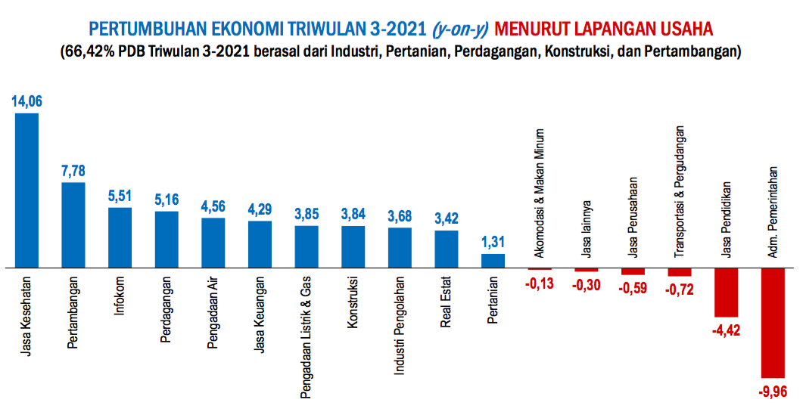
Sumber: BPS, 2021
This document has been prepared for discussion purposes only. Please do not quote or cite without author's permission.

Slide 3
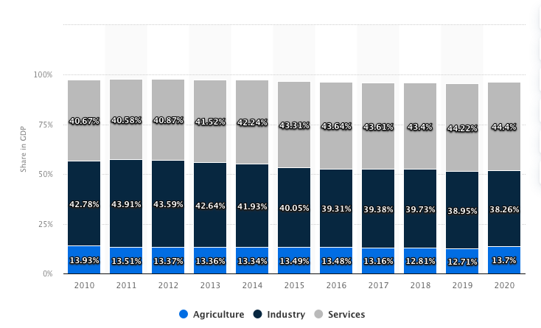
Kontribusi Sektor Pertanian Terbatas
Sumber: Statista, 2021
This document has been prepared for discussion purposes only. Please do not quote or cite without author's permission.

Slide 4
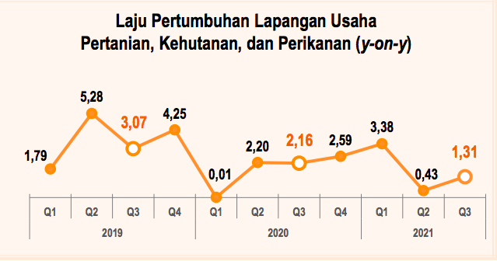
Kontribusi Sektor Pertanian Terbatas
Kontribusi sektor pertanian dibanding sektor lain relatif kecil
Pertumbuhan sektor pertanian sesuai dengan siklus bisnis di sektor pertanian
Sumber: BPS, 2021
This document has been prepared for discussion purposes only. Please do not quote or cite without author's permission.

Slide 5
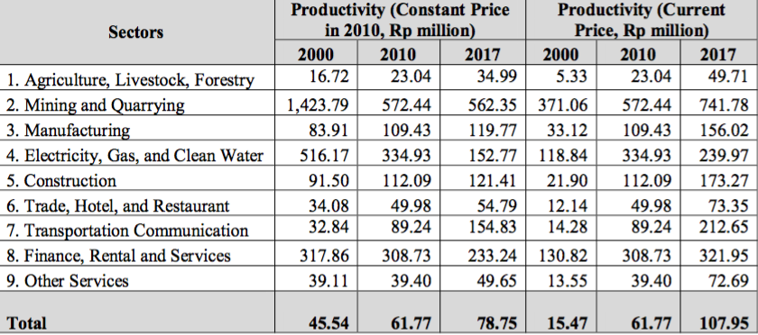
Permasalahan Fundamental Sektor Pertanian Produktivitas rendah
Sumber: Sakernas 2000, 2010, 2017
This document has been prepared for discussion purposes only. Please do not quote or cite without author's permission.

Slide 6
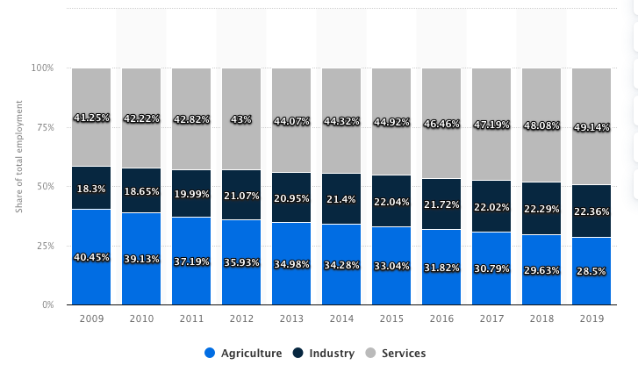
Permasalahan Fundamental Sektor Pertanian Jumlah Tenaga Kerja Menurun
Sumber: Statista, 2021
Sumber: Sakernas 2000, 2010, 2017
This document has been prepared for discussion purposes only. Please do not quote or cite without author's permission.

Slide 7
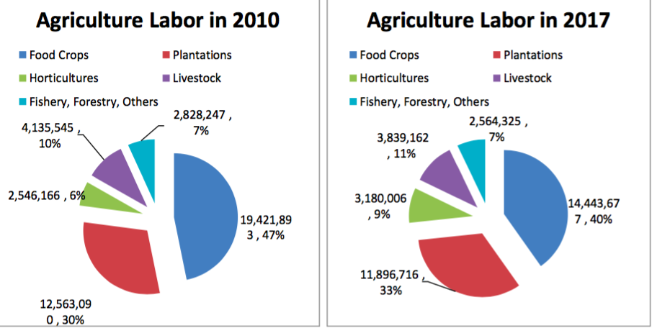
Permasalahan Fundamental Sektor Pertanian Jumlah Tenaga Kerja di Sektor Pertanian Menurun
Sebagian besar bekerja di Pangandan perkebunan
Sumber: Sakernas 2000, 2010, 2017
This document has been prepared for discussion purposes only. Please do not quote or cite without author's permission.

Slide 8
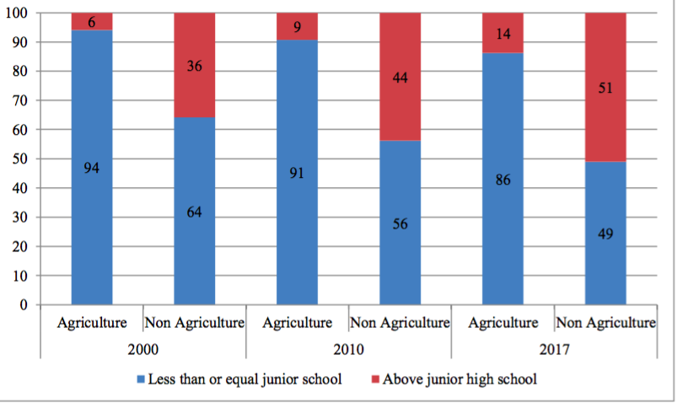
Permasalahan Fundamental Sektor Pertanian Tingkat Pendidikan Tenaga Kerja Rendah
Sebagian besar berpendidikan kurang atau lulus Sekolah Menengah Pertama (SMP)
Sumber: Sakernas 2000, 2010, 2017
This document has been prepared for discussion purposes only. Please do not quote or cite without author's permission.

Slide 9
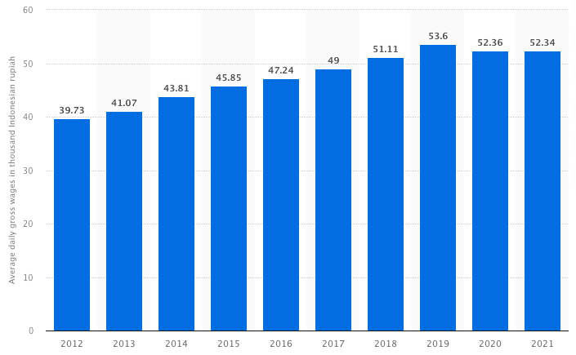
Permasalahan Fundamental Sektor Pertanian Upah Tenaga Kerja Rendah dan stagnan
Upah tenaga kerja sekitar Rp 39.730 – Rp 52.340 per hari selama tahun 2012 sampai 2021
Tidak heran, jumlah rumah tangga miskin terbesar berasal dari sektor pertanian (46,32%) dari total rumah tangga miskin di Indonesia.
Sumber: Statista, 2021
This document has been prepared for discussion purposes only. Please do not quote or cite without author's permission.

Slide 10
Permasalahan Fundamental Sektor Pertanian Modal Terbatas dan Alokasi Kredit Kecil
 | 2014 | 2015 | 2016 | 2017 | 2018 | 2019 | 2020 | Share 2020
Sektor Perdagangan Besar dan Eceran | 716,733 | 792,503 | 841,384 | 885,454 | 975,995 | 1,006,069 | 942,188 | 25.99
Sektor Industri Pengolahan | 660,536 | 760,048 | 781,765 | 824,109 | 899,088 | 931,727 | 893,642 | 24.65
Sektor Pertanian, Perburuan, dan Kehutanan | 212,386 | 254,954 | 283,827 | 317,379 | 354,878 | 369,903 | 385,586 | 10.64
Sektor Transportasi, Pergudangan dan Komunikasi | 171,805 | 177,546 | 171,795 | 182,628 | 217,323 | 246,935 | 266,189 | 7.34
Sektor Perantara Keuangan | 166,182 | 164,681 | 193,946 | 214,185 | 244,486 | 249,782 | 216,297 | 5.97
Sektor Real Estate, Usaha Persewaan dan Jasa Perusahaan | 165,466 | 184,755 | 209,999 | 221,923 | 248,218 | 269,360 | 259,978 | 7.17
Sektor Konstruksi | 147,266 | 172,934 | 214,757 | 258,931 | 316,097 | 362,271 | 376,473 | 10.38
Sektor Listrik, Gas dan Air | 81,130 | 99,447 | 135,461 | 146,133 | 170,190 | 198,255 | 168,881 | 4.66
Sektor Penyediaan Akomodasi dan Penyediaan Makan Minum | 73,583 | 85,861 | 93,390 | 97,886 | 99,751 | 109,842 | 116,183 | 3.20
Dalam Miliar Rupiah
Sumber: Bank Indonesia, 2021
This document has been prepared for discussion purposes only. Please do not quote or cite without author's permission.

Slide 11
Thank you
INDEF
Indef@indef.or.id
http://indef.or.id

Slide 12
ABOUT US
The Institute for Development of Economics and Finance (INDEF) is an independent research institution on economy and finance established on August 1995 in Jakarta.
INDEF does research and policy studies on a wide-range of economic and finance issues, as well as raise participation and public awareness in decision making process.
We also contribute to search the viable solutions for the complex economic and social problems in Indonesia.
INDEF
@2020 INDEF, Institute for Development of Economics and Finance. This presentation is the property of INDEF and is strictly confidential. It contains information intended only for the person to whom it is transmitted. Document Classifications: INDEF Confidential

